Slide 1
Edge detection
By Mariami Garuchava

Slide 2

Digital Images, Edges, and Derivatives
Edge is a rapid change in image intensity in a small region.
The boundary between black and white represents a clear and sharp edge.

Slide 3
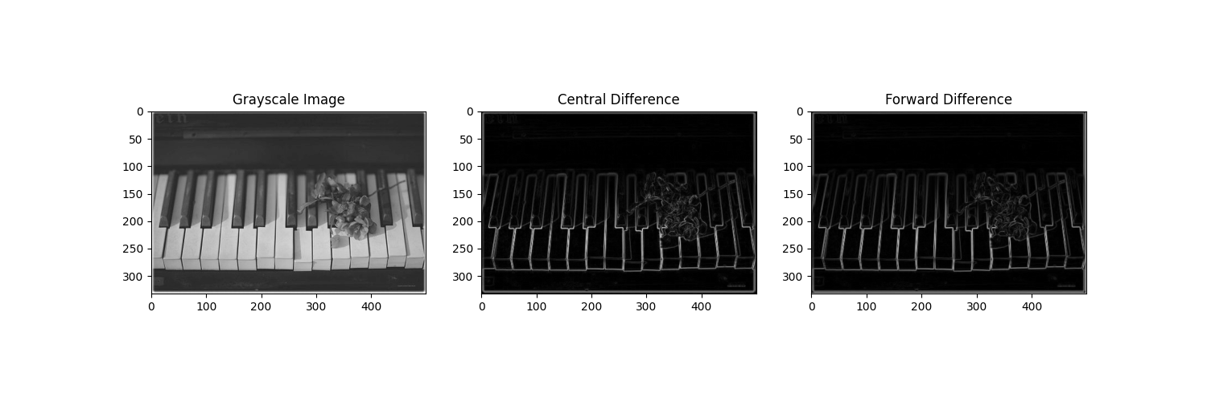

Slide 4
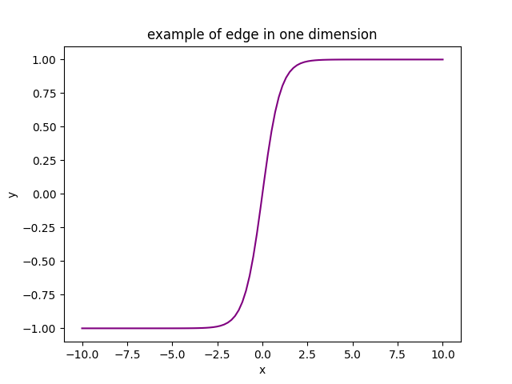
Edge detection in one dimension
Edge is here for this one-dimensional function:

Slide 5
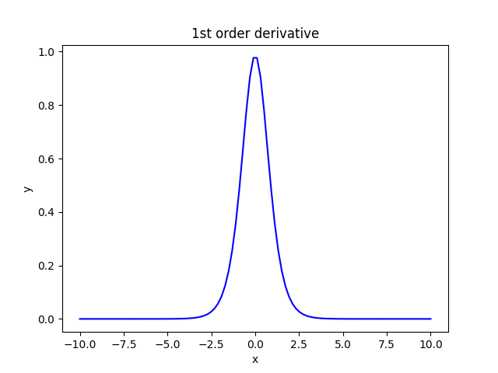
Local extrema indicates edges when we use the first derivative
Local Maxima

Slide 6
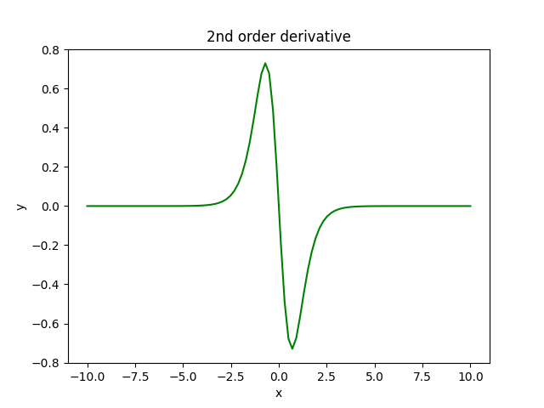
Edge indicator is the zero-crossing for the second-order derivative

Slide 7



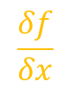
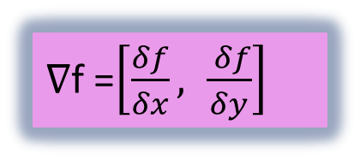
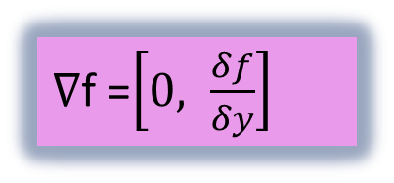
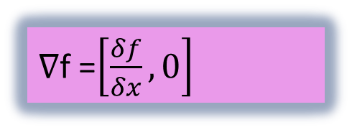
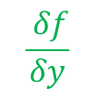
Edge detection in two dimensions
We need to calculate the gradient of an image, which is a measure of change in image function, F(x,y) in x and y.
$$\frac{δf}{δx}$$
$$\frac{ δf}{δy}$$
∇f =$\left[\frac{δf}{δx}, 0\right]$
∇f =$\left[0, \frac{δf}{δy}\right]$
∇f =$\left[\frac{δf}{δx}, \frac{ δf}{δy}\right]$

Slide 8
Digital Images, Features, and Higher Order Derivatives
Truncation error in finite difference formulas can significantly impact edge detection algorithms that rely on these approximations for computing derivatives. Edge detection helps identify the edges of objects within an image.
Finite difference formulas are commonly used to approximate derivatives in numerical analysis and image processing. These formulas involve truncating the Taylor series expansion of the function at a certain order, leading to truncation errors.

Slide 9
The magnitude of the truncation error depends on the order of the finite difference formula and the smoothness of the function being approximated.
To illustrate the impact of truncation error on edge detection, I will use the Sobel operator, which is a popular edge detection algorithm that relies on finite difference approximations of the gradient.

Slide 10

This is the original Image

Slide 11
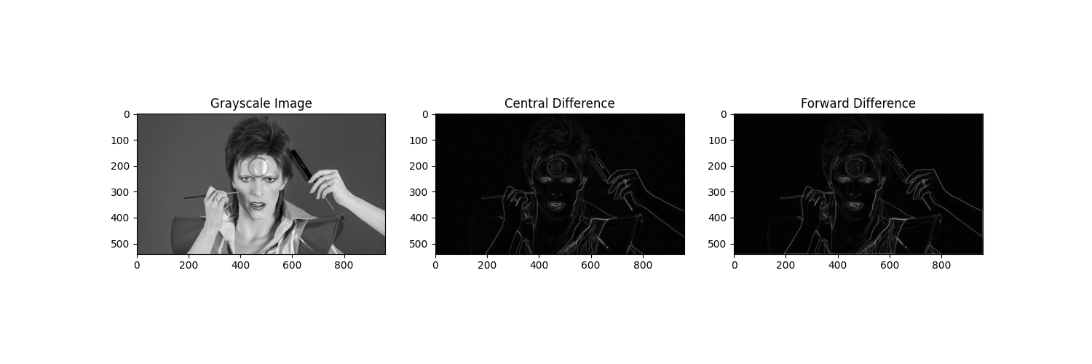

Slide 12
The central difference formula has a higher accuracy order than the forward difference formula.
This visualization shows us that:
The central difference approach provides a slightly more accurate representation of the edges, with sharper and better-defined edge profiles.

Slide 13
Digital Images, Features, and Higher Order Derivatives
Higher-order derivatives offer an alternative approach to edge detection in digital images, beyond the commonly utilized first-order gradients. While higher-order derivatives, like the Laplacian operator, can reveal detailed local features, they are more sensitive to noise and errors. Despite this drawback, they provide valuable insights into the intricate structures within an image. The Laplacian operator, in particular, sums second-order partial derivatives to highlight edges, exhibiting zero values in uniform regions, positive values on one side of edges, and negative values on the other. This versatility underscores the potential of higher-order derivatives in enhancing edge detection algorithms, as demonstrated in the utilization of the Laplacian operator.

Slide 14
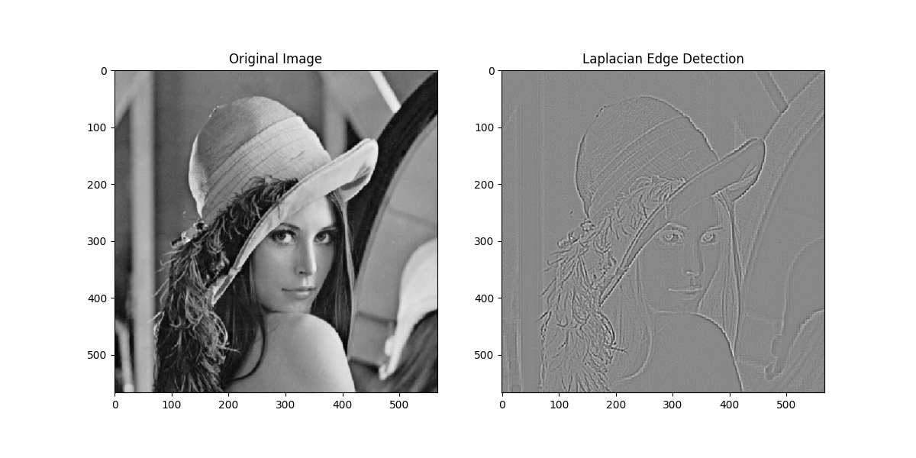
In this example, the Laplacian operator effectively highlights the edges in the image. However, it's also sensitive to noise, which can lead to spurious edges or artifacts.

Slide 15
Exploring the potential of higher order derivatives in extracting other features of digital images
Blobs are regions in an image that differ in properties (such as brightness or color) from their surroundings. Blob detection is essential for various applications, including object recognition, segmentation, and tracking. The Laplacian of Gaussian (LoG) operator, which is based on the second-order derivative of the Gaussian function, is commonly used for blob detection. The LoG operator enhances regions with rapid intensity changes, such as blobs, by approximating the second-order derivative of the image.

Slide 16
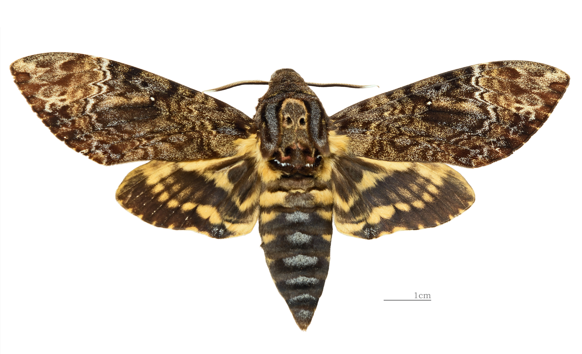
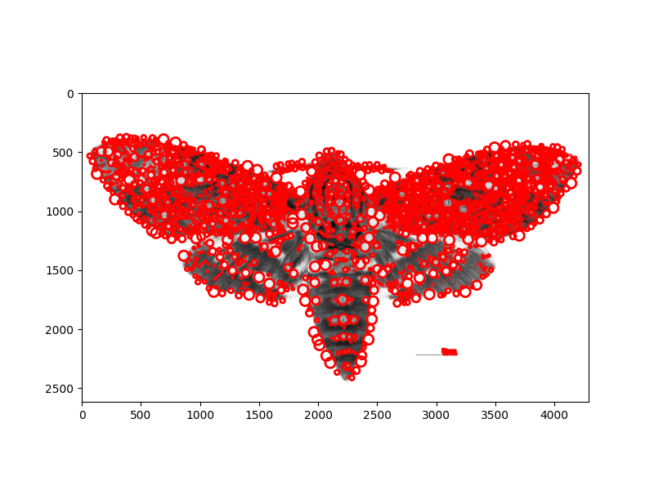
Here's an example for blob detection:

Slide 17
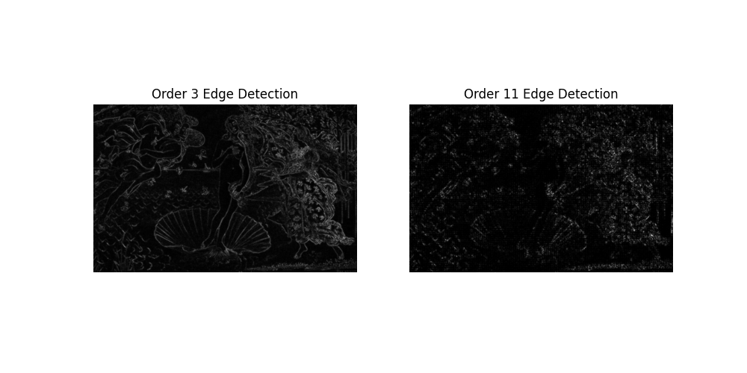
Unsuccessful findings by using higher order derivatives

Slide 18
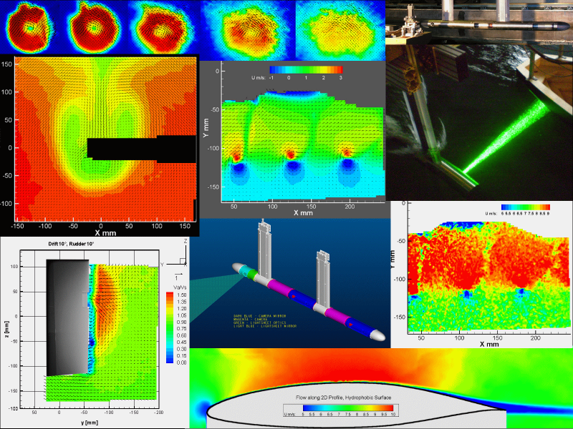
Fluid Dynamics
Derivatives in real-world scenarios
Edge detection techniques are employed in the analysis of flow visualization images, such as those obtained from particle image velocimetry (PIV) or schlieren imaging. Edge detection helps in identifying and tracking flow patterns, shocks, and other features in fluid flows.

Slide 19
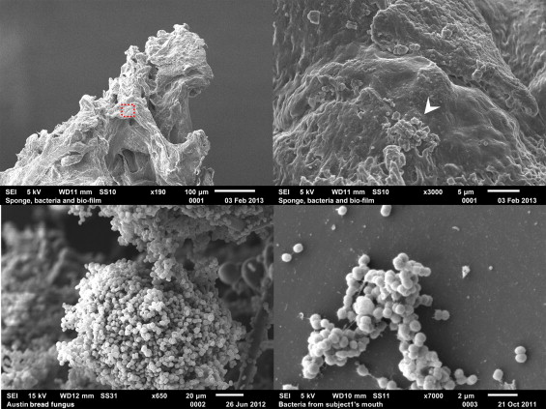
Edge Detection in Scanning Electron Microscope (SEM) Images using Various Algorithms.
Sobel, Laplacian, and Hough Transform detection algorithm is used to detect the edges and remove noise at the same time in SEM images for both metal and non-metal images. To compare these algorithms by using various parameters like the speed of execution, noise removal, and accuracy in edge detection. Laplacian gives better result compared to other detection algorithms in terms of voids, boundary, lines or curves and orientation detection.

Slide 20
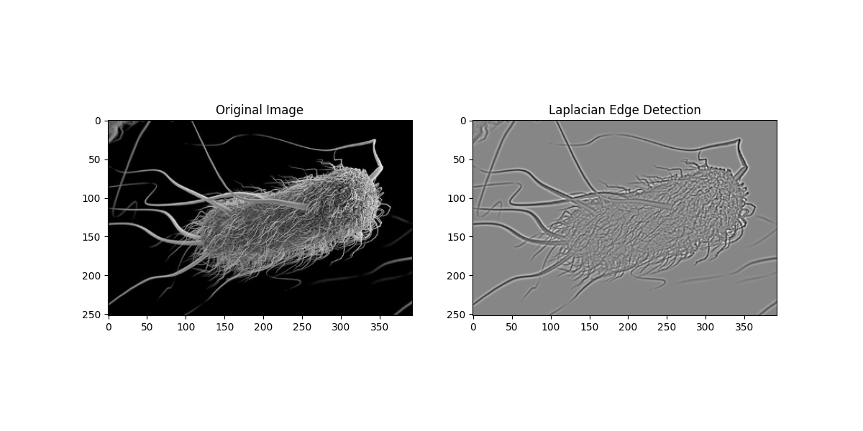
Visual representation for Scanning Electron Microscope

Slide 21
Digital Images, Features, and Linear Combinations of Derivatives
Linear combinations of derivatives can be employed for edge detection. That involves convolving the image with derivative kernels, such as Sobel to compute the first-order derivatives in different directions. Derivative represents the rate of change of pixel intensities in the image along different axes.

Slide 22
Linear combinations of derivatives can be effectively utilized not only for edge detection but also for extracting various other features from digital images. For example:
Blob detection
Curvature estimation
Corner detection

Slide 23
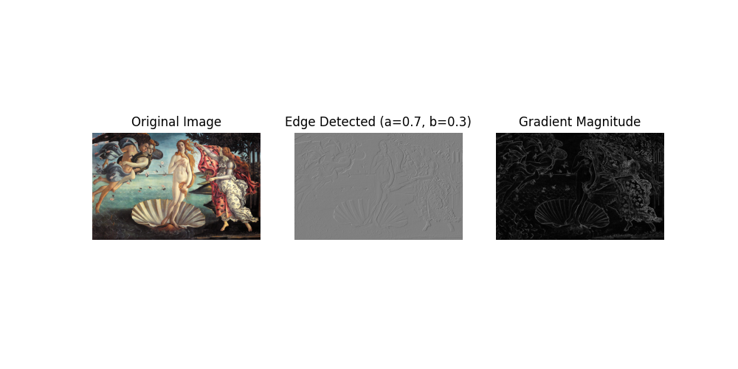
Successful choice of coefficients (a=0.7, b=0.3) and derivatives

Slide 24
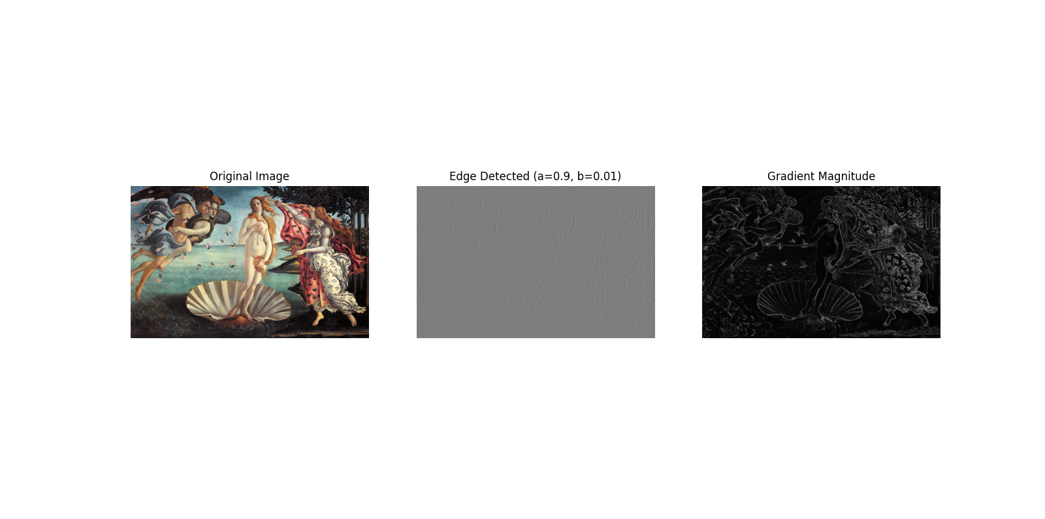
Unsuccessful choice of coefficients and derivatives

Slide 25
Thank you!

